Slide 1
BUSINESS SHARE APPLICATION
By
BALAJI PRAME B
2019272006
Guided By
DURAIMURUGAN.J

Slide 2
INTRODUCTION
The project is about to gathering individuals to connect together and start a new business solution. Someone might have an idea of the project but they might not have resource to execute the business solution process.
someone having a resource to do some business but they don’t have idea of business solution. At this situation our Application play major role to connect these people to become the business partners.

Slide 3
Problem statement
There are many person who has idea or have the source to start a business but they need a essential partner to start up the business so this application will help to post their ideas to start up the business
Business idea person who are looking for partners can update their business ideas here. Once they update their details regarding the ideas, the users can look up the requirement and choose their business ideas.
The business are categorised according to the different streams . In this, the admin authorises both the business partners’ and the candidates’ personal and business profiles. The business partners can contact the job seekers using the in-built chat box.
Using AES128 (Advance Encryption Standards) ALGORITHM the password is encrypted and stored in the database so that the details cannot be viewed and the user email will be verified to check whether the user is authorized or not and then the profile will be allowed to post their respective ideas and source in this application

Slide 4
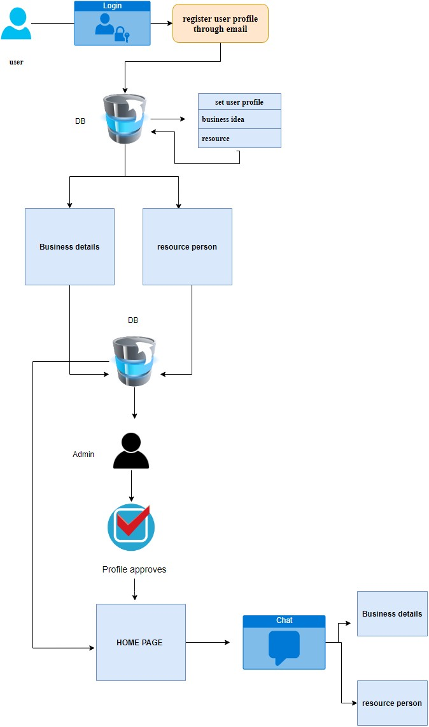
ARCHITECTURE

Slide 5
Module
Admin login:-where the admin verify the user is a authorized are not and get his/her response to the portal
User login:-The user can get into the portal and choose their respective module whether he has an idea to implement or resource
User profile: User can create whether its their business profile or resource profile
Chat:-where both the users can interact with each other

Slide 6
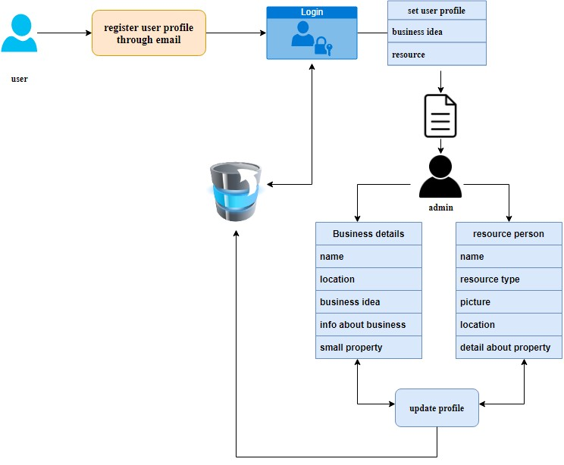
PROFILE CREATION :

Slide 7
Security
If a ideology person wants to contact to resource or a resource person wants to contact the business idea person through the chat then both will have the access notification
The idea’s/resources are specifically categorized for the easy search
Document verification process will be checked manually by the admin and allow the user to get into the application
If a scam profile got caught then his profile will be deactivated through admin panel

Slide 8
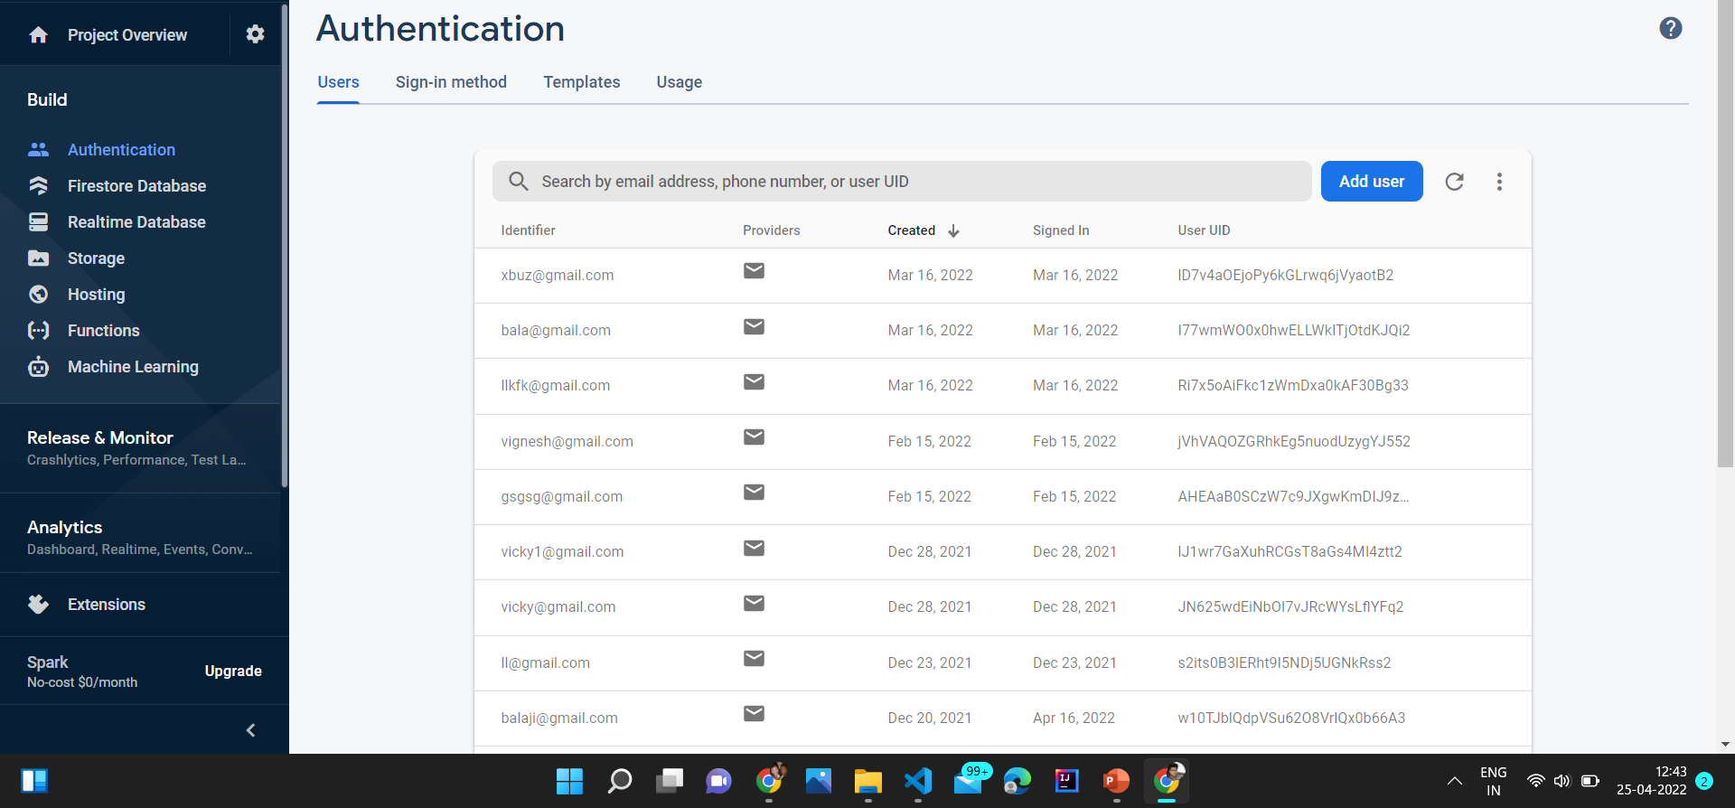
FirebASE

Slide 9
Software Requirements:
Front end : FLUTTER
Back end : FIRE BASE
Operating System : Windows
Hardware Requirements:
Processor – core i3
Hard Disk – 1TB
Memory – 8GB RAM

Slide 10
LITERATURE REVIEW
s.no | Paper title | Used technology & Requirement | Author name | Published In
1 | Financial Analysis as a Franchising Tool in Modern Conditions of Digitalization of the Economy | Framework on franchising agreement, Machine Learning (ML) | Z. P. Samokhvalova, L. I. Artanova | 2021 Intelligent Technologies and Electronic Devices in Vehicle and Road Transport Complex (TIRVED)
2 | Real Time Stock Market Analysis | Machine Learning (ML), Support Vector Machine (SVM) | Avita Katal, Ridhima, Naman Adlakha | 2021 International Conference on System, Computation, Automation and Networking (ICSCAN)

Slide 11
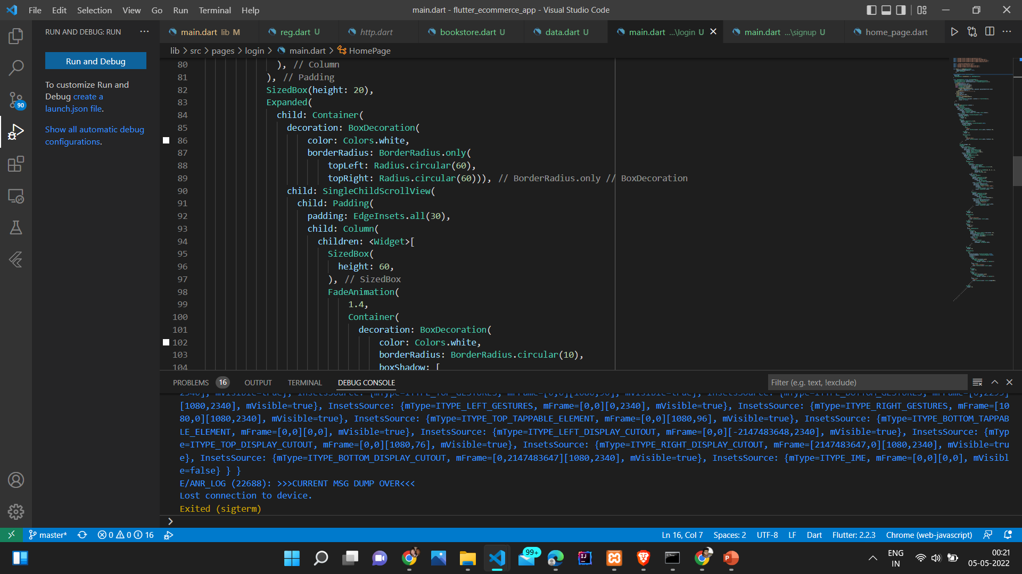
CONTAINER CREATION

Slide 12
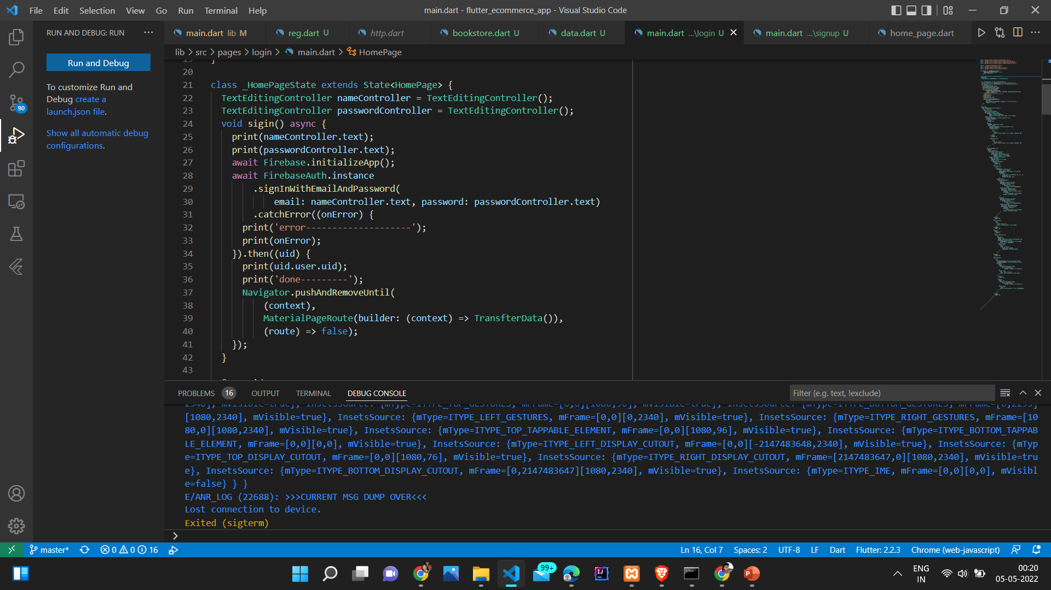
FIREBASE AUTHENTICATION

Slide 13
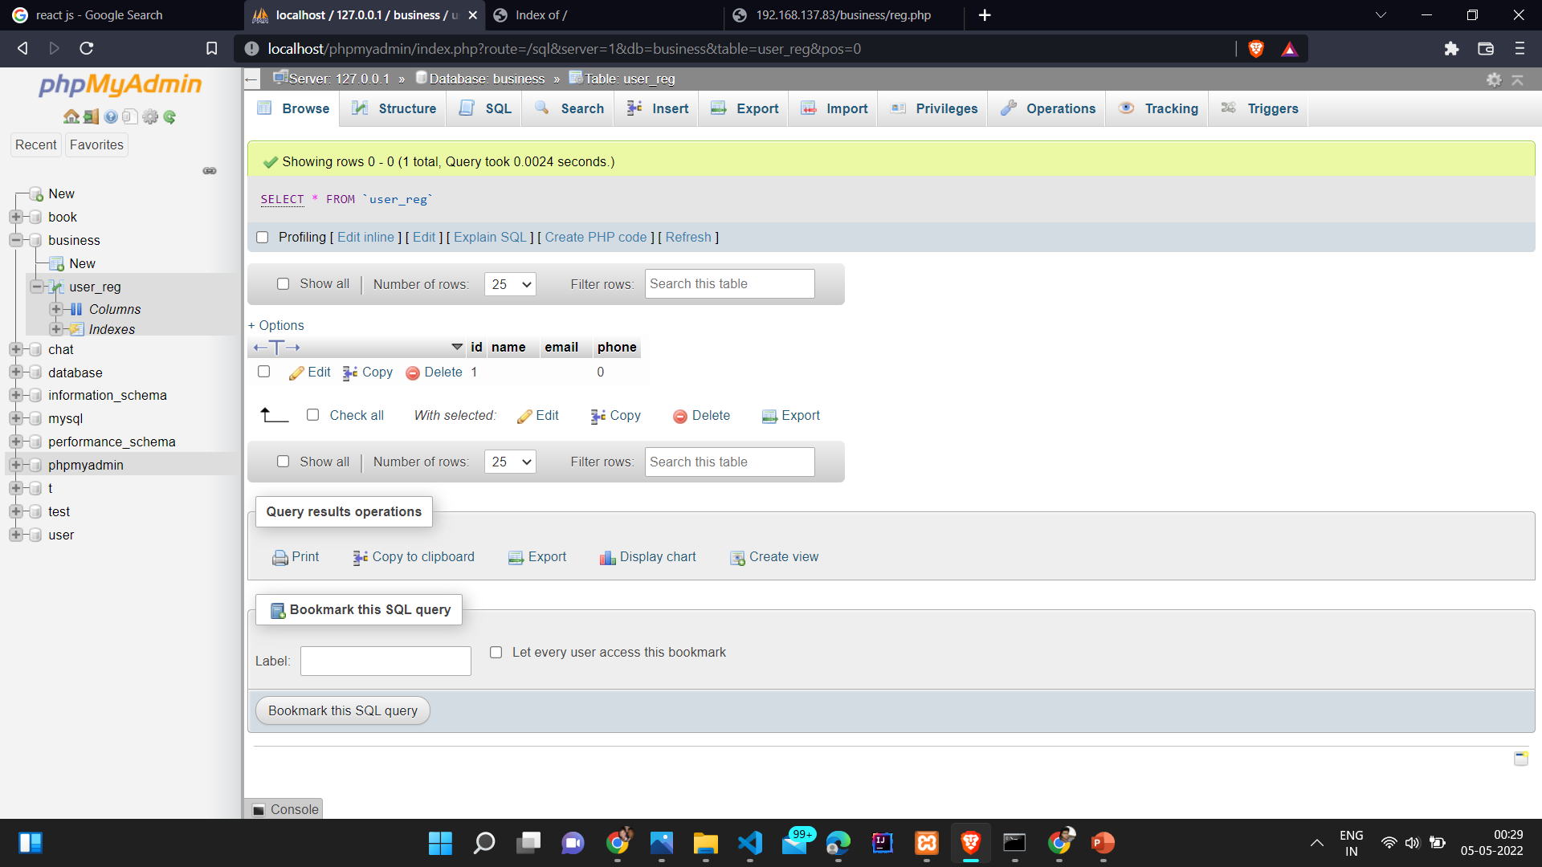
MY SQL FOR USER DATA

Slide 14
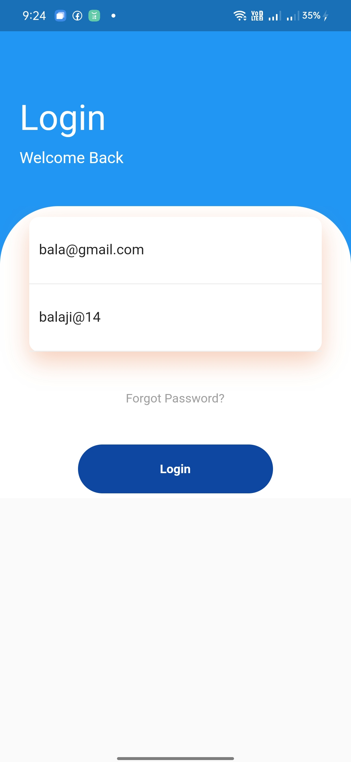

Slide 15
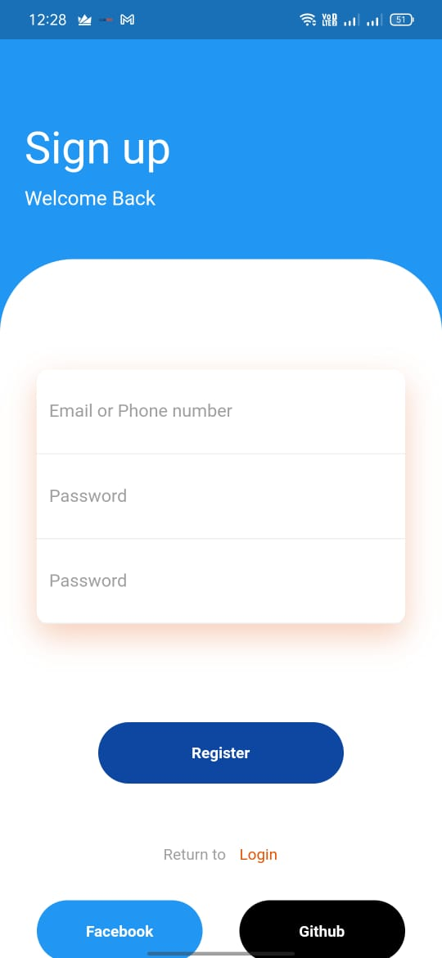

Slide 16
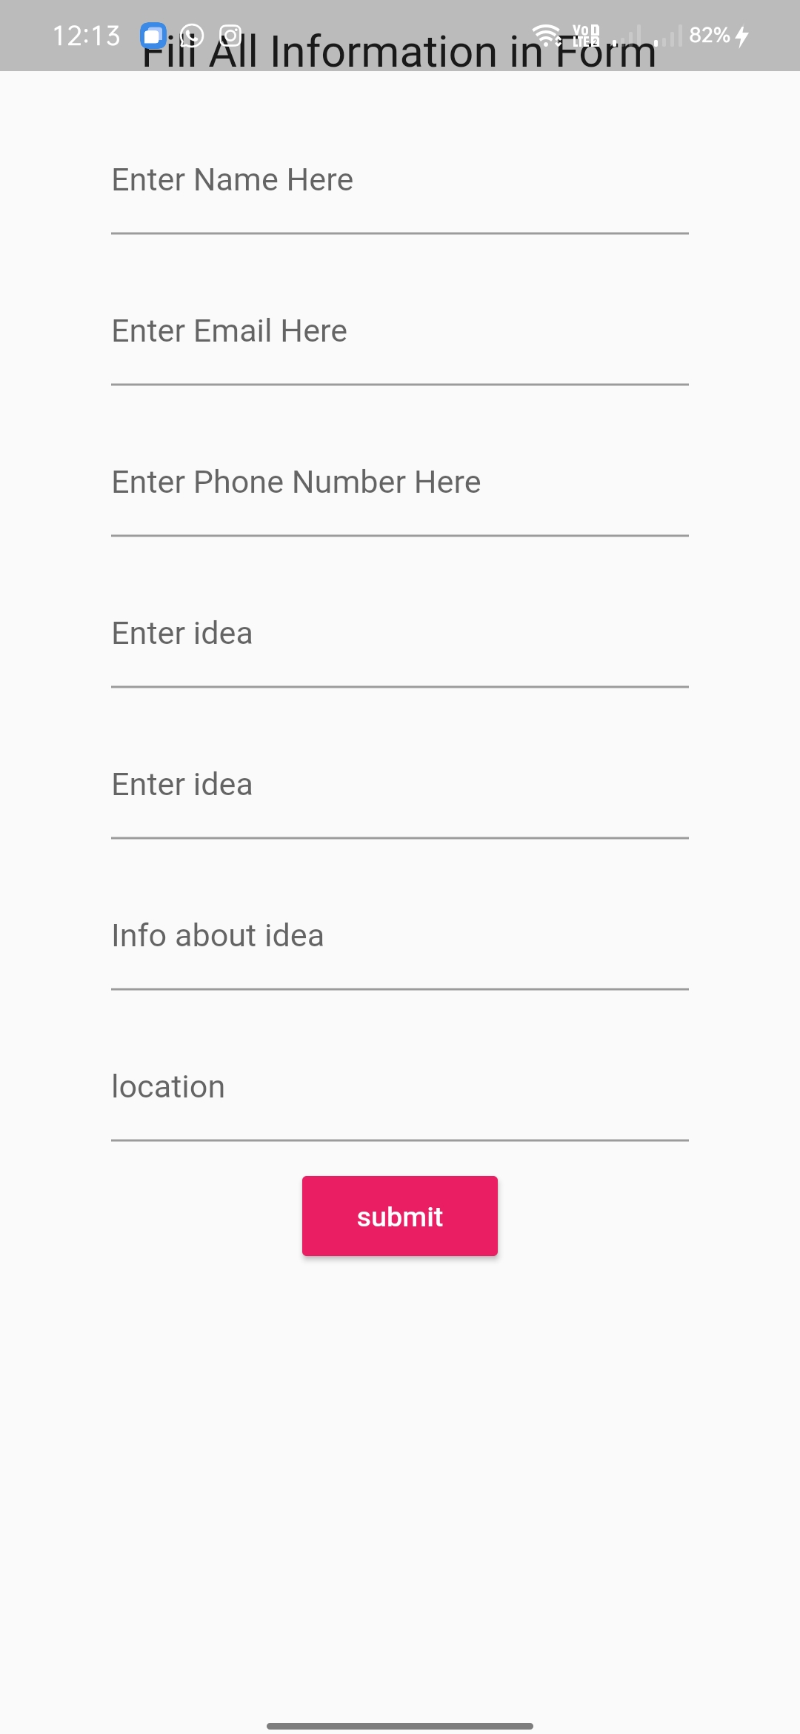

Slide 17
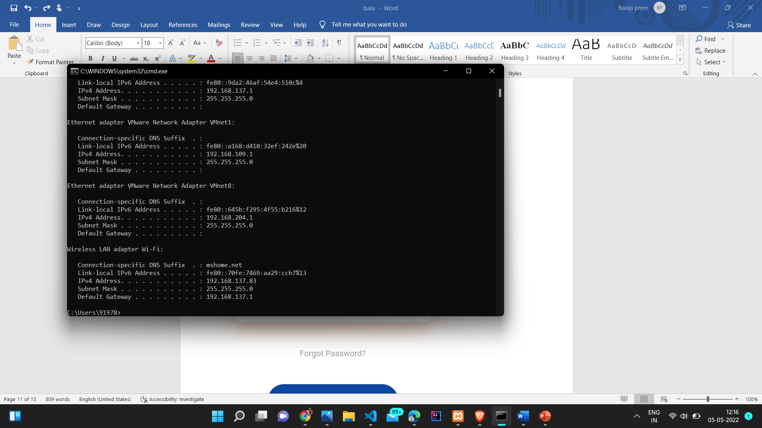

Slide 18
REFERENCES
https://www.javatpoint.com/flutter-container
https://www.javatpoint.com/flutter-widgets
https://firebase.google.com/
https://serversmtp.com/what-is-smtp-server

Slide 19
Thank you !

